Slide 1
SOFTWARE CONFIGURATION MANAGEMENT

Slide 2
Configuration Management Activities (Recap)
Configuration item identification
Configuration Management Directories
Baselining
Branch management
Version Management
Build Management
Install Management
Change Management
Promotion management
Release management
Defect Management

Slide 3
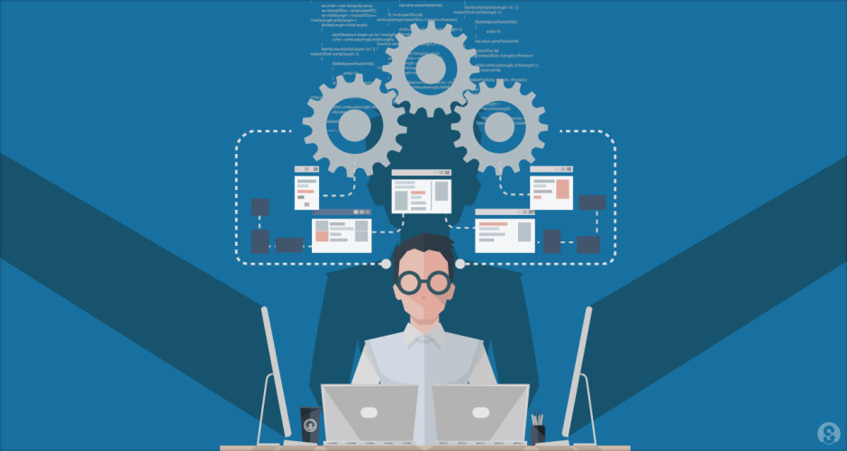
Some of the basic activities and structures of SCM

Slide 4
1. Configuration Items
Definition : Any independent or aggregation of hardware, software, or both, that is designated for configuration management and treated as a single entity in the configuration management process”
Software configuration items could be
all type of code files
drivers for tests
Requirement, analysis, design, test & other non-temporary documents
user or developer manuals
system configurations (e.g. version of compiler used) .. Etc.
Systems can have software and hardware configuration items (CPUs ..)
Large projects typically produce thousands of entities (files, documents, data ...) which are uniquely identified and can potentially be brought under configuration management control

Slide 5
1. Configuration Items (Cont.)
Challenges associated with configuration Items :
Since not all entities in an project needs to be under configuration management, this leads to two challenges
What are those items which need to be in Configuration Control (Selection) Some items must be maintained for the lifetime of the software.
Selecting the right configuration items is a skill that takes practice
Very similar to object modeling
Use techniques similar to object modeling for finding CIs!
Find the CIs
Find relationships between CIs drivers for tests
When do you start to place entities under configuration control?
Considerations on when to start:
Starting with CIs too early introduces too much bureaucracy
Starting with CIs too late introduces chaos

Slide 6
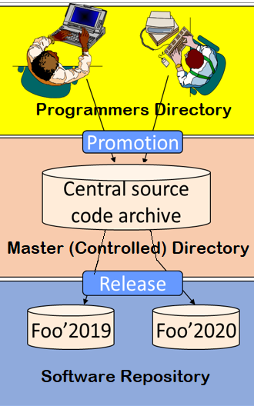
2. SCM Directories - Code as an CI
Programmer’s Directory (IEEE: Dynamic Library)
Library for holding newly created or modified software entities.
The programmer’s workspace is controlled by the programmer only.
Master Directory (IEEE: Controlled Library)
Manages the current baseline(s) and for controlling changes made to them.
Entry is controlled, usually after verification.
Changes must be authorized.
Software Repository (IEEE: Static Library)
Archive for the various baselines released for general use.
Copies of these baselines may be made available to requesting organizations.

Slide 7
3. Baselines
Definition : A specification or product that has been formally reviewed and agreed to by responsible management, that thereafter serves as the basis for further development, and can only be changed through formal change control procedures
As systems are developed, a series of baselines are developed, usually after a review (analysis review, design review, code review, system testing, client acceptance, ...)
Examples:
Baseline A: All the API have completely been defined; the bodies of the methods are empty.
Baseline B: All data access methods are implemented and tested.

Slide 8
3. Baselines (Cont.)
Baseline A (developmental)
All changes relative to baseline A
Baseline B (functional, first prototype)
All changes relative to baseline B
Baseline C (functional, beta test)
All changes relative to baseline C
Official Release (Product)
Time
Are baselines tied to project milestones?
Many are, but is not mandatory
There are many naming schemes for baselines (1.0, 6.01a, ...)

